Slide 1

Optimal Racing using MPC with a Novel Repetitive Observer Semester Project – Midterm presentation Gregor Gärtner
Supervision: Dr. Andrea Carron, Dr. Johannes Köhler, Prof. Melanie Zeilinger
25.11.2024, Zurich

Slide 2

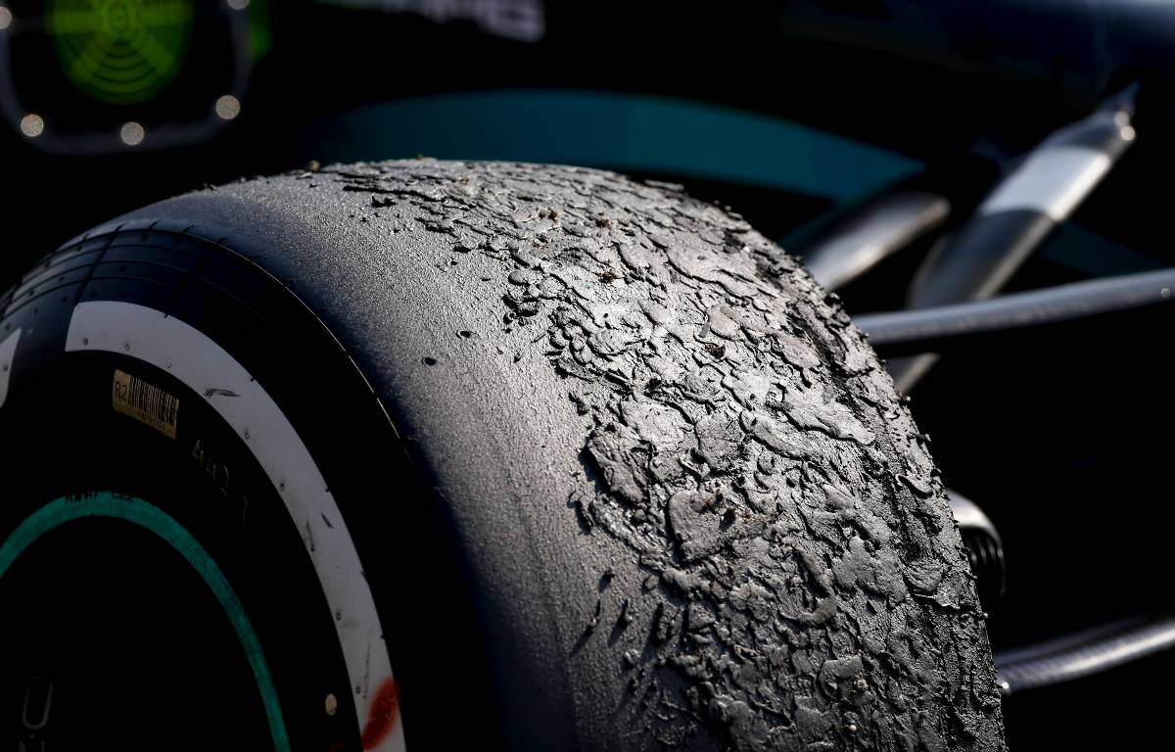
Motivation
No perfect model → suboptimal control
Many tasks are periodic → make use of periodicity
Notes:
Dynamics may also change over time

Slide 3
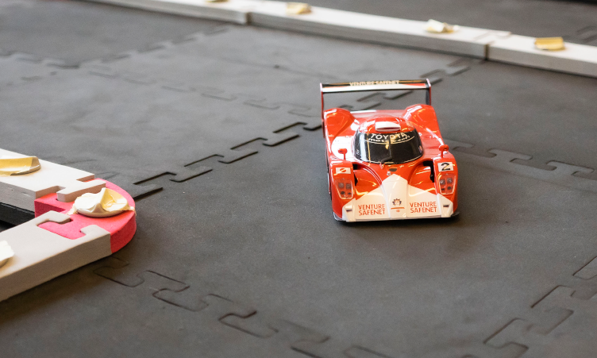
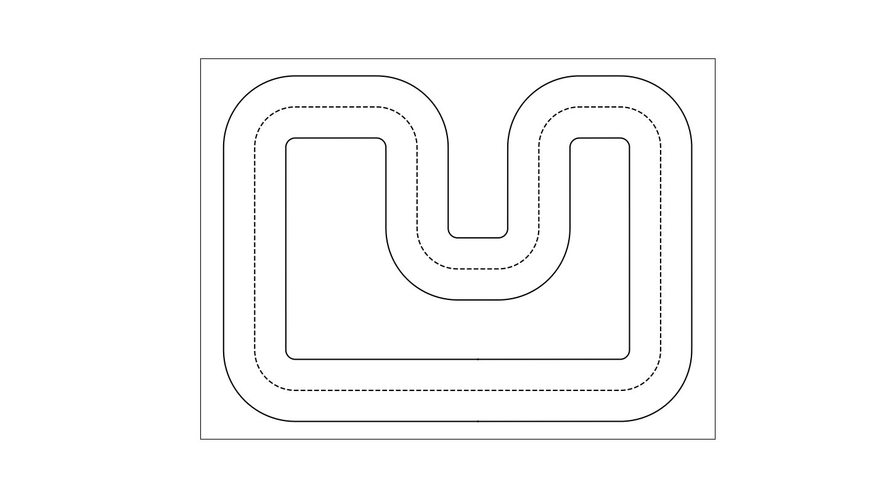
Project introduction
Goal of the project
Optimal racing of the miniature race car despite model mismatch
Make use of periodicity of racing around a track

Slide 4
Project introduction
Goal of the project
Optimal racing of the miniature race car despite model mismatch
Make use of periodicity of racing around a track

Slide 5
Related work
Gaussian Process-Based Error Correction
PI-MPC
[1]
[2]
Fit a GP using measurements
Adjust reference trajectory in the cost:
Periodic disturbance observer
Adjust dynamics and trajectory accordingly
t
[1] E. D. Klenske, M. N. Zeilinger, B. Schölkopf and P. Hennig, "Gaussian Process-Based Predictive Control for Periodic Error Correction," in IEEE Transactions on Control Systems Technology, vol. 24, no. 1, pp. 110-121, Jan. 2016.
[2] L. Pabon, J. Köhler, J. I. Alora, P. B. Eberhard, A. Carron, M. N. Zeilinger, M. Pavone, "Perfecting Periodic Trajectory Tracking: Model Predictive Control with a Periodic Observer ($Π$-MPC)." arXiv preprint arXiv:2404.01550 (2024).
Notes:
Emphasize that this is for periodic tasks. So e.g. say that the GP has among others a periodic kernel that can predict the periodic behavior

Slide 6
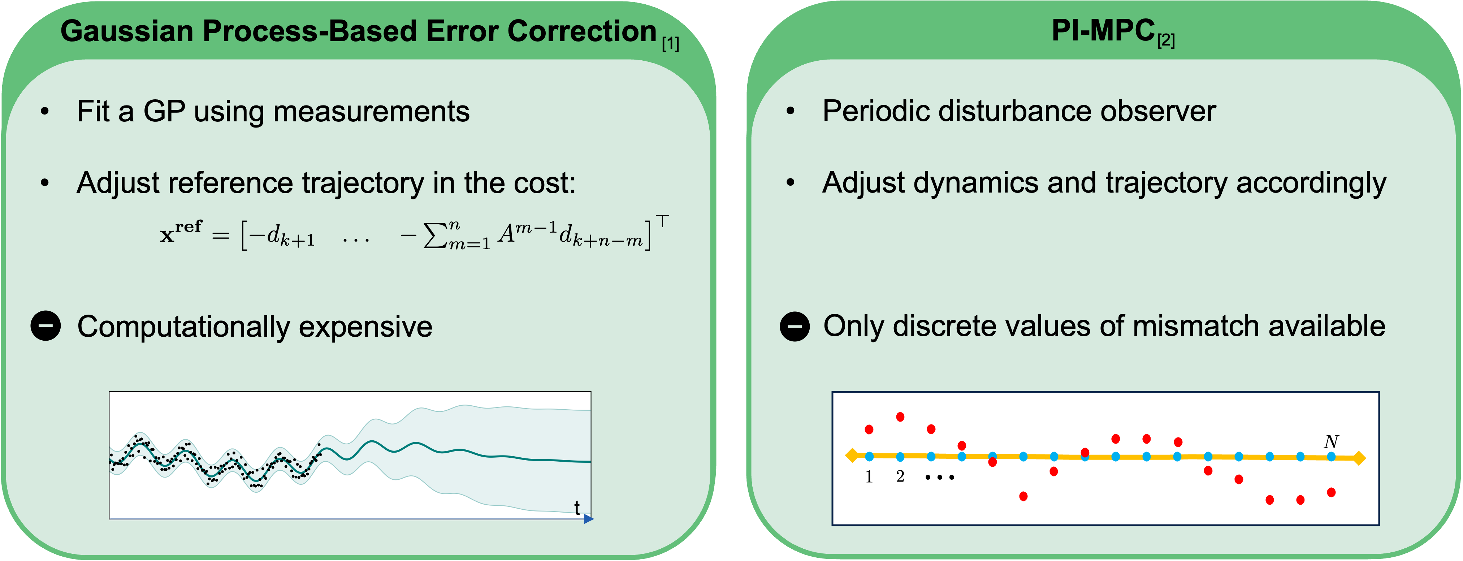

Related work
Gaussian Process-Based Error Correction
PI-MPC
[1]
[2]
Fit a GP using measurements
Adjust reference trajectory in the cost:
Periodic disturbance observer
Adjust dynamics and trajectory accordingly
Both do trajectory tracking
Computationally expensive
Only discrete values of mismatch available
t
[1] E. D. Klenske, M. N. Zeilinger, B. Schölkopf and P. Hennig, "Gaussian Process-Based Predictive Control for Periodic Error Correction," in IEEE Transactions on Control Systems Technology, vol. 24, no. 1, pp. 110-121, Jan. 2016.
[2] L. Pabon, J. Köhler, J. I. Alora, P. B. Eberhard, A. Carron, M. N. Zeilinger, M. Pavone, "Perfecting Periodic Trajectory Tracking: Model Predictive Control with a Periodic Observer ($Π$-MPC)." arXiv preprint arXiv:2404.01550 (2024).

Slide 7
Path Following rather than Trajectory Tracking
Model Predictive Contouring Controller (MPCC)
Disturbance estimate parameterized in progress along track

Slide 8
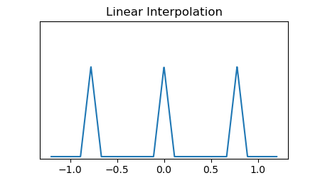
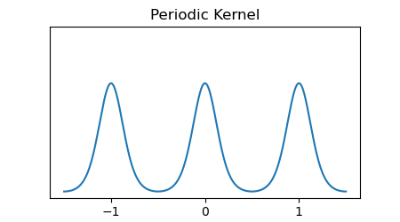
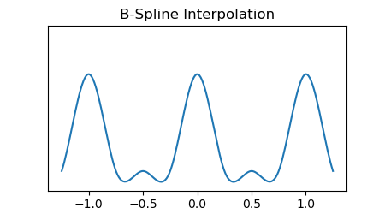
Parameterization
Parameterizations of
Linear Interpolation
Periodic Kernel
B-Spline
Notes:
Implemented in casadi in a way that you can get the Jacobian which is important for the optimization

Slide 9
Parameterization
Continuous function
Linear in
Estimating weights using KF
Notes:
Johannes: I personally would emphasize (at least when saying it) that Phi(\theta) is piece-wise differentiable, periodic, and defined for all \theta.

Slide 10
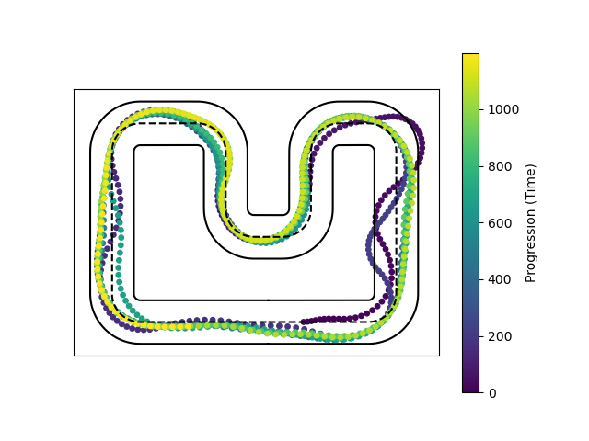
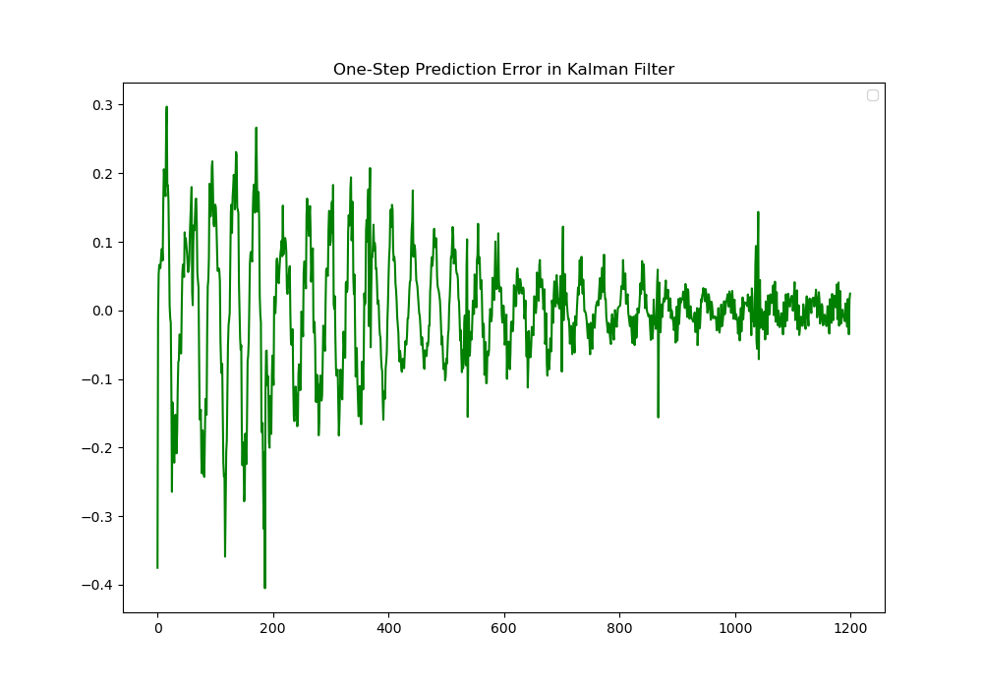
Simulation
Setup
Dynamic Bicycle Model
MPCC + Kalman Filter
Disturbed state: angular rate
Time steps: 1/30s
Horizon length: 20

Slide 11
Conclusion
Work so far
Implemented simulation with MPCC
Added disturbance and estimated it using KF
Integrated disturbance estimate into MPCC
→ Proof of concept ✔
25.11.24

Slide 12
Conclusion
Work so far
Implemented simulation with MPCC
Added disturbance and estimated it using KF
Integrated disturbance estimate into MPCC
→ Proof of concept ✔
Remaining To-Dos
Trials with real-world Chronos data
Implement on hardware
(Theoretical guarantees)

Slide 13
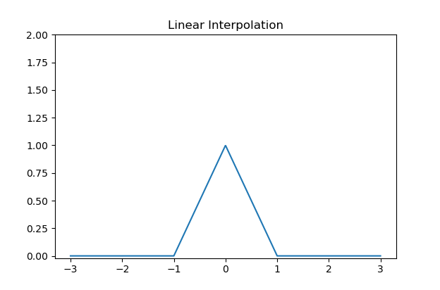
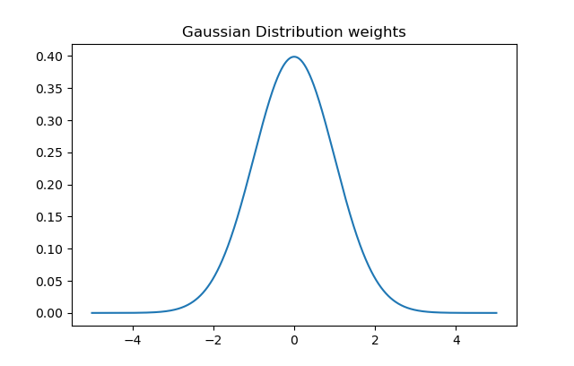
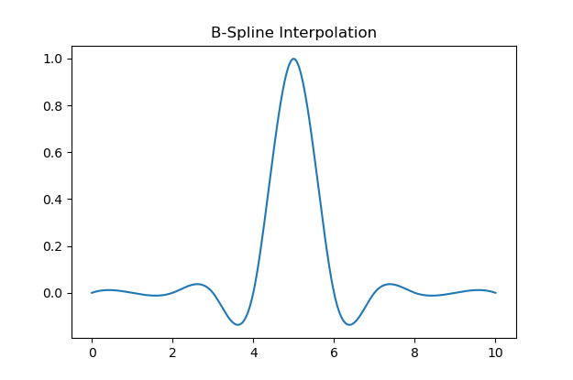
Parameterization
Consider 3 different ways to compute weights in
- linear interpolation
- square-exponential
- casadi bspline

Slide 14
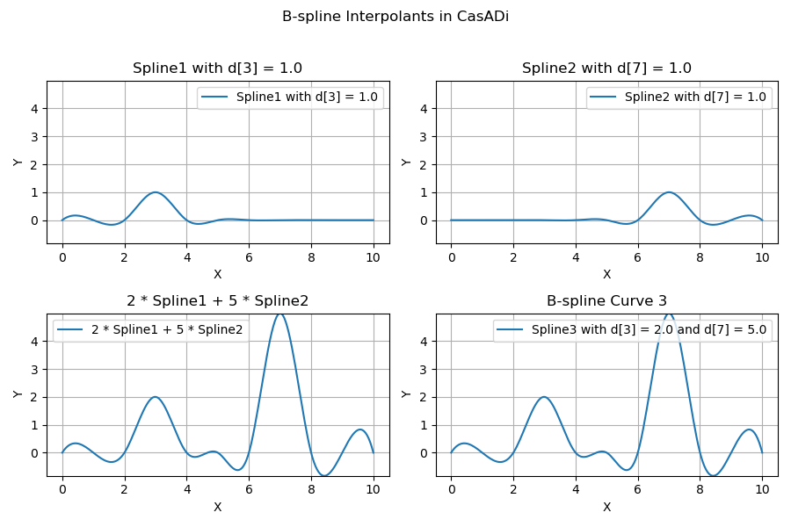
Why casadi bspline
Also results in a nice, smooth function
Convenietly implemented in casadi
Can be implemented by directly providing vector of Inference points

Slide 15
Bicycle model and Pacejka Tire forces
Bicycle Model:
Pacejka Tire Model:
[3]
[3] Liniger, Alexander, Alexander Domahidi, and Manfred Morari. "Optimization‐based autonomous racing of 1: 43 scale RC cars." Optimal Control Applications and Methods 36.5 (2015): 628-647.

Slide 16
Model Predictive Contouring Control
Cost terms:
Additional dynamics:
[3]
[3] Liniger, Alexander, Alexander Domahidi, and Manfred Morari. "Optimization‐based autonomous racing of 1: 43 scale RC cars." Optimal Control Applications and Methods 36.5 (2015): 628-647.

Slide 17
Path Following rather than Trajectory Tracking
Model Predictive Contouring Controller (MPCC)
Disturbance estimate parameterized in progress along track

